Slide 1




Next Gen Employability Program
FullStack Web Development With AI Tools
Team Details – NG_CP_Team_344
Name: Vishal
Name: Ujjwal
Name: Manvi Singhal
Name: Charu Singh
College: Meerut Institute of Technology, Meerut

Slide 2


Slide 3

Project Title
YATRIGANN
Notes:
In this slide speaker will be introducing the program and its outcomes. The speaker will introduce himself in brief

Slide 4

Table of Contents
Introduction
Problem Statement
Proposed Solution
Key features
Technology stack
System flowchart
Core Modules
Security measures
Conclusion and Future work
References
Notes:
This slide, The speaker will talk about the content that we will be covering in this session as follows:
Introduction
Importance of UI/UX in industry
History and Definitions of UI and UX
Key Differences between UI/UX
Use Cases
Significance in Web Development
Use Cases
Visual Design Principles
Design process
Color theory and psychology
Typography and readability
Layout and Spacing
Responsive design basics
Usability and Accessibility
Usability Aspects
Web Content Accessibility Guidelines (WCAG)
Inclusive design practices
Consistency
User Experience
User-Centered Design
User research methods
Interactive Elements and Feedback
Mini Case Study
Discussing a popular UI/UX design
Hands-On
Introduction to Figma for UI/UX design

Slide 5
Introduction:
YATRIGANN is a comprehensive, full-stack travel service portal designed to bridge the gap between complex travel databases and the end-user. The project aims to provide a unified platform where travelers can seamlessly browse and book flights and hotels. Unlike generic travel sites, YATRIGANN focuses on a clean, high-performance user experience (UX) and a dedicated management interface for real-time data administration.
Notes:
This slide, The speaker will talk about the content that we will be covering in this session as follows:
Introduction
Importance of UI/UX in industry
History and Definitions of UI and UX
Key Differences between UI/UX
Use Cases
Significance in Web Development
Use Cases
Visual Design Principles
Design process
Color theory and psychology
Typography and readability
Layout and Spacing
Responsive design basics
Usability and Accessibility
Usability Aspects
Web Content Accessibility Guidelines (WCAG)
Inclusive design practices
Consistency
User Experience
User-Centered Design
User research methods
Interactive Elements and Feedback
Mini Case Study
Discussing a popular UI/UX design
Hands-On
Introduction to Figma for UI/UX design

Slide 6
PROBLEM STATEMENT:
The modern travel planning landscape is often hindered by:
Information Overload: Many existing platforms are cluttered with excessive advertisements and complex navigation.
Lack of Management Transparency: Users often struggle with opaque booking processes, while administrators lack easy-to-use tools for updating real-time data.
Disconnected Services: A frequent lack of synergy between flight and hotel search results often forces users to toggle between multiple websites.
Notes:
This slide, The speaker will talk about the content that we will be covering in this session as follows:
Introduction
Importance of UI/UX in industry
History and Definitions of UI and UX
Key Differences between UI/UX
Use Cases
Significance in Web Development
Use Cases
Visual Design Principles
Design process
Color theory and psychology
Typography and readability
Layout and Spacing
Responsive design basics
Usability and Accessibility
Usability Aspects
Web Content Accessibility Guidelines (WCAG)
Inclusive design practices
Consistency
User Experience
User-Centered Design
User research methods
Interactive Elements and Feedback
Mini Case Study
Discussing a popular UI/UX design
Hands-On
Introduction to Figma for UI/UX design

Slide 7
PROPOSED SOLUTION:
YATRIGANN proposes a streamlined travel ecosystem built on the Django framework and MySQL. The solution involves:
A centralized dashboard that categorizes travel services into intuitive modules (Flights and Hotels).
A custom Admin Management Portal that removes the need for direct database manipulation, allowing authorized staff to manage services via a web-based CRUD (Create, Read, Update, Delete) interface.
Dynamic UI filtering that adjusts navigation based on user intent, ensuring a focused and efficient search journey.
Notes:
This slide, The speaker will talk about the content that we will be covering in this session as follows:
Introduction
Importance of UI/UX in industry
History and Definitions of UI and UX
Key Differences between UI/UX
Use Cases
Significance in Web Development
Use Cases
Visual Design Principles
Design process
Color theory and psychology
Typography and readability
Layout and Spacing
Responsive design basics
Usability and Accessibility
Usability Aspects
Web Content Accessibility Guidelines (WCAG)
Inclusive design practices
Consistency
User Experience
User-Centered Design
User research methods
Interactive Elements and Feedback
Mini Case Study
Discussing a popular UI/UX design
Hands-On
Introduction to Figma for UI/UX design

Slide 8
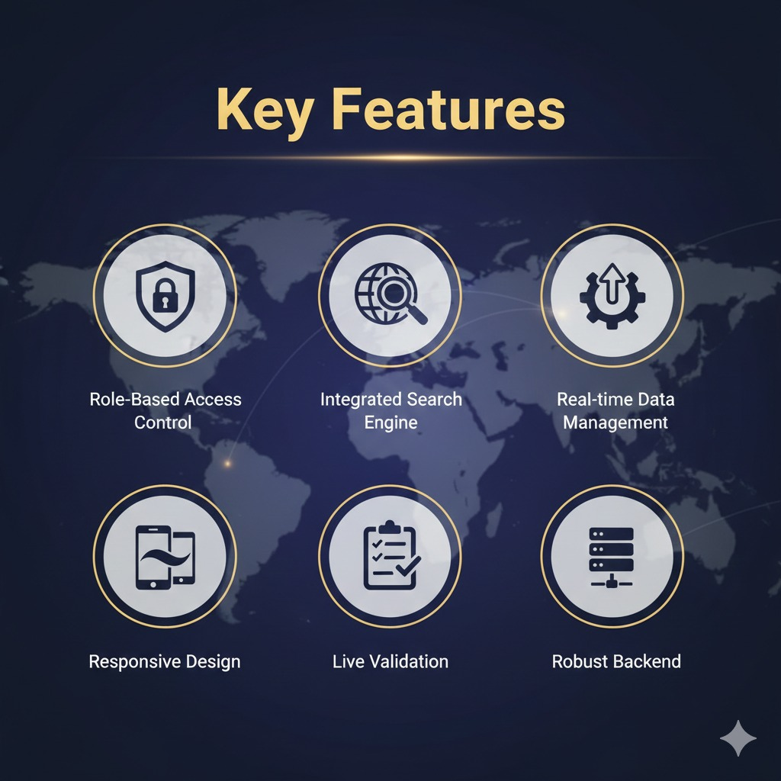
KEY FEATURES:
Role-Based Access Control: Separate interfaces and permissions for regular users and superusers.
Integrated Search Engine: Intelligent filtering of services based on categories and destinations.
Real-time Data Management: A frontend admin panel for instant addition or removal of travel listings.
Responsive Design: A purple-themed, mobile-friendly interface built with Bootstrap 5.
Live Validation: Secure Sign-up and Login forms with real-time error handling.
Notes:
This slide, The speaker will talk about the content that we will be covering in this session as follows:
Introduction
Importance of UI/UX in industry
History and Definitions of UI and UX
Key Differences between UI/UX
Use Cases
Significance in Web Development
Use Cases
Visual Design Principles
Design process
Color theory and psychology
Typography and readability
Layout and Spacing
Responsive design basics
Usability and Accessibility
Usability Aspects
Web Content Accessibility Guidelines (WCAG)
Inclusive design practices
Consistency
User Experience
User-Centered Design
User research methods
Interactive Elements and Feedback
Mini Case Study
Discussing a popular UI/UX design
Hands-On
Introduction to Figma for UI/UX design

Slide 9
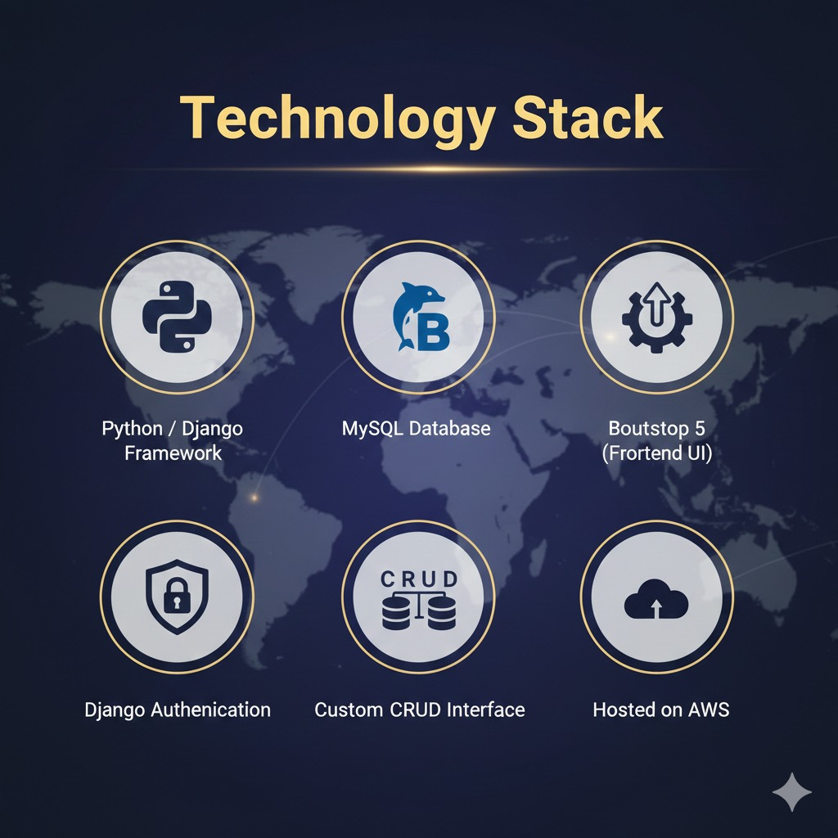
TECHNOLOGY STACK:
1. Frontend
HTML5, CSS3, JavaScript and Bootstrap 5
2. Backend
Python – Django Framework
3.Database
MySQL for structured data storage
4. Authentication
Django's built-in User Authentication System for secure session management.
Notes:
This slide, The speaker will talk about the content that we will be covering in this session as follows:
Introduction
Importance of UI/UX in industry
History and Definitions of UI and UX
Key Differences between UI/UX
Use Cases
Significance in Web Development
Use Cases
Visual Design Principles
Design process
Color theory and psychology
Typography and readability
Layout and Spacing
Responsive design basics
Usability and Accessibility
Usability Aspects
Web Content Accessibility Guidelines (WCAG)
Inclusive design practices
Consistency
User Experience
User-Centered Design
User research methods
Interactive Elements and Feedback
Mini Case Study
Discussing a popular UI/UX design
Hands-On
Introduction to Figma for UI/UX design

Slide 10
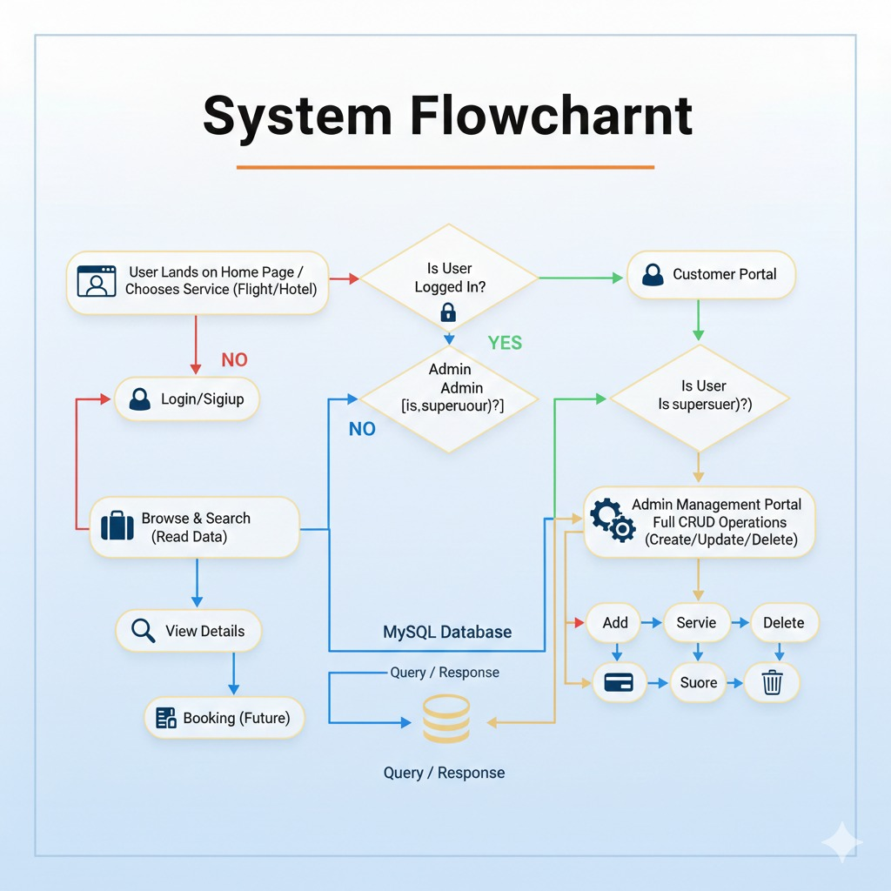
SYSTEM FLOWCHART:
SYSTEM FLOW CHART
Service
Store
Notes:
This slide, The speaker will talk about the content that we will be covering in this session as follows:
Introduction
Importance of UI/UX in industry
History and Definitions of UI and UX
Key Differences between UI/UX
Use Cases
Significance in Web Development
Use Cases
Visual Design Principles
Design process
Color theory and psychology
Typography and readability
Layout and Spacing
Responsive design basics
Usability and Accessibility
Usability Aspects
Web Content Accessibility Guidelines (WCAG)
Inclusive design practices
Consistency
User Experience
User-Centered Design
User research methods
Interactive Elements and Feedback
Mini Case Study
Discussing a popular UI/UX design
Hands-On
Introduction to Figma for UI/UX design

Slide 11
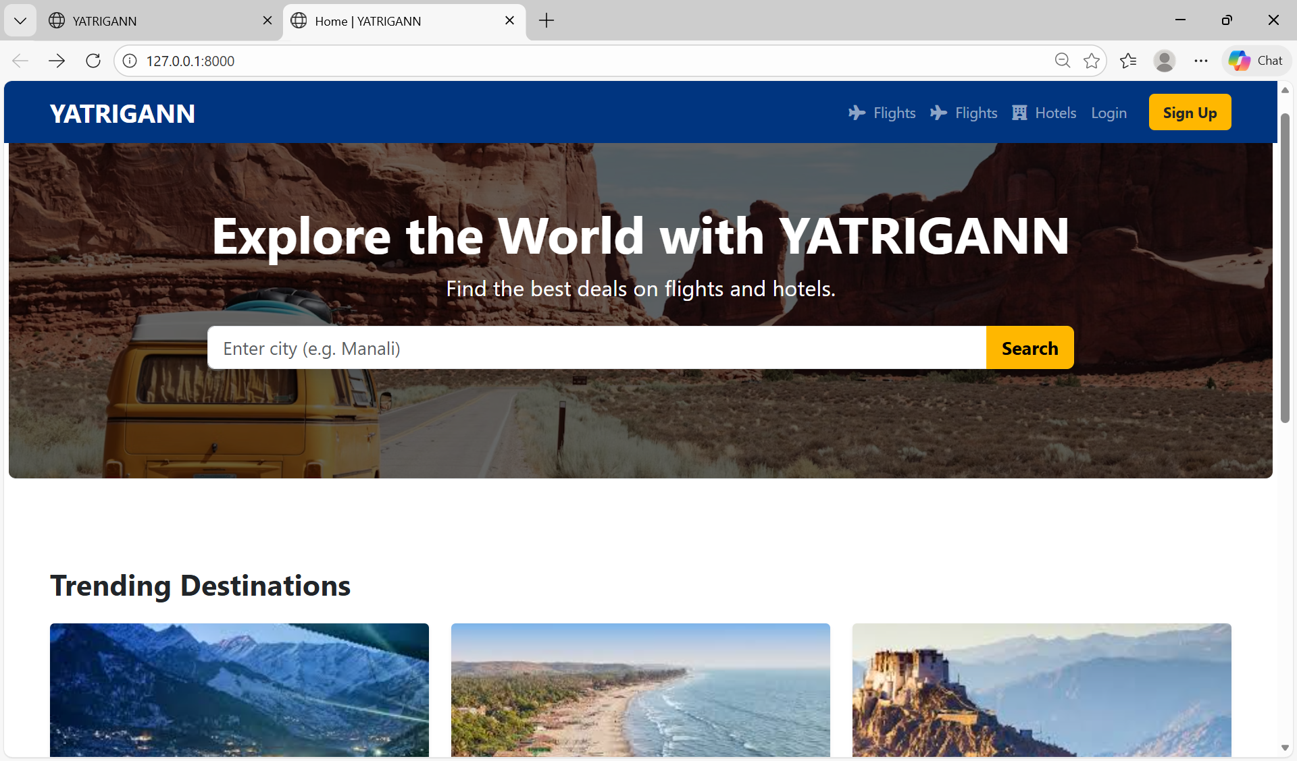
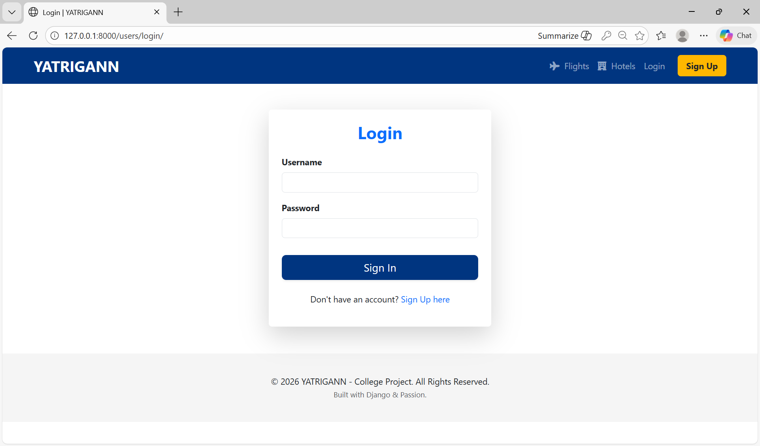

Slide 12
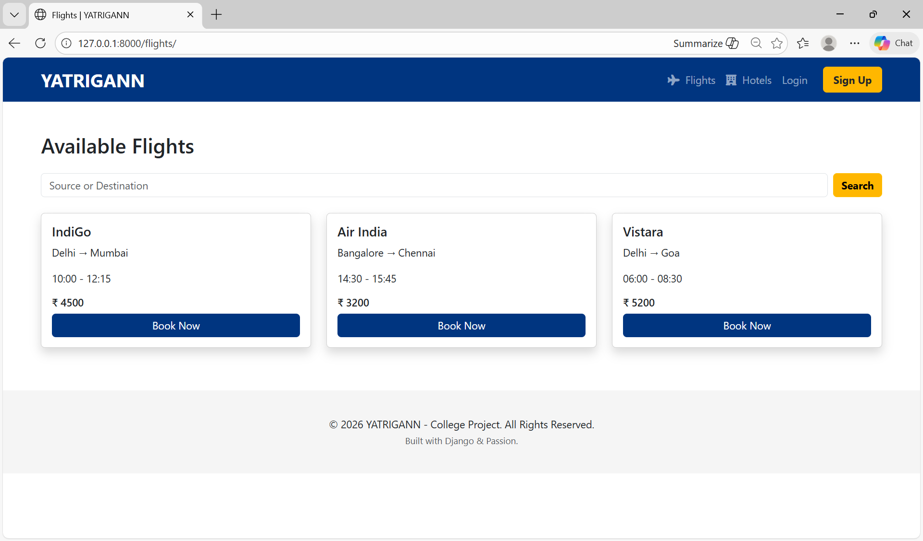
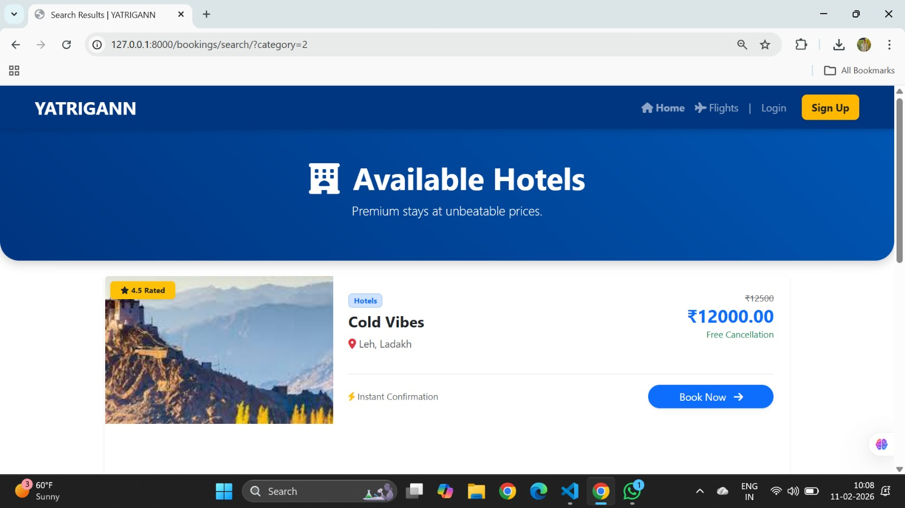

Slide 13
CONCLUSION AND FUTUREWORK:
YATRIGANN successfully demonstrates a scalable travel management system.
Future Work will involve:
Payment Gateway Integration: Razorpay for live transactions.
Automated Email Notifications: Sending PDF tickets and confirmations upon booking.
AI-Driven Recommendations: Using machine learning to suggest destinations based on user history.

Slide 14
References:
Django Documentation - https://docs.djangoproject.com/en/6.0/
Bootstrap 5 - https://getbootstrap.com/docs/5.0/getting-started/introduction/
MySQL Database Administration- https://dev.mysql.com/doc/
Python Software Documentation - https://docs.python.org/3/reference/index.html
W3Schools - https://www.w3schools.com/sql/
Gemini – https://www.gemini.google.com
ChatGPT – https://chat.openai.com
Notes:
This slide, The speaker will talk about the content that we will be covering in this session as follows:
Introduction
Importance of UI/UX in industry
History and Definitions of UI and UX
Key Differences between UI/UX
Use Cases
Significance in Web Development
Use Cases
Visual Design Principles
Design process
Color theory and psychology
Typography and readability
Layout and Spacing
Responsive design basics
Usability and Accessibility
Usability Aspects
Web Content Accessibility Guidelines (WCAG)
Inclusive design practices
Consistency
User Experience
User-Centered Design
User research methods
Interactive Elements and Feedback
Mini Case Study
Discussing a popular UI/UX design
Hands-On
Introduction to Figma for UI/UX design

